Slide 1

Web Development 1
© Matt Smith 2008-2014
Lecture 7a
Using Flex boxes to create horizontal nav bars

Slide 2
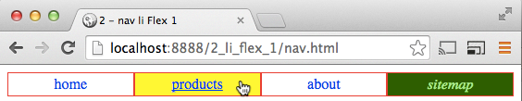
Horizontal navigation bar what will will learn to create today
Horizontal nav bar
Expands to fill full screen width
Each item equally spaced

Slide 3
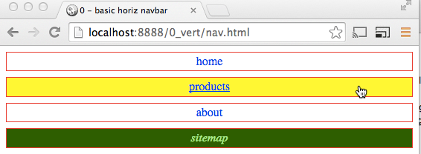
RECAP –
3 steps for vertical nav bars

Slide 4
nav ul {
list-style-type: none;
margin: 0;
padding: 0;
}
nav a {
display: block;
border: 0.1rem solid red;
padding: 0.2rem;
margin-bottom: 0.5rem;
text-decoration: none;
text-align: center;
}
nav a:hover {
text-decoration: underline;
background-color: yellow;
}
nav a.current_page {
color: lightgreen;
background-color: darkgreen;
font-style: italic;
}
1. Remove ‘nav ul’ bullets/spacing
2. Links display as block
3. Style rules for a / a:hover / a. .current_page
CSS

Slide 5
Basic vertical navbar

Slide 6
Horizontal navbars
Using flex boxes

Slide 7
3 + 2 = 5 steps for horizontal navbars
Three (3) steps for basic vertical navigation bars
<ul> remove bullets and margins and padding
<a> display as blocks
<a> define a / a:hover / a. .current_page styles
+ (add some pretty CSS colors/padding/border etc.)
Two (2) new steps for full horizontal navbars:
Horiz-1: Make list block ‘nav ul’ a flex box container
Horiz-2: Make the list items ‘nav li’ share space flexibly

Slide 8
STEP: horiz-1
Make ‘nav ul’ block a FLEX container

Slide 9
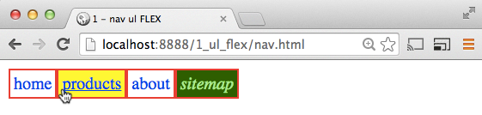
step horiz-1
core of horizontal navbars is UL flex box
Child blocks line up left-to-right
nav ul {
display: flex;
}

Slide 10
STEP: horiz-2
Make ‘nav li’ items expand (flex) to use up extra space

Slide 11
step horiz-2
If all list items have flex ratio of ‘1’, they take an equal share of remaining horizontal space
So the list items will expand to ‘spread’ out
nav li {
flex: 1;
}

Slide 12
Summary and Conclusions

Slide 13
steps horiz-1 & 2
2 simple rules to change vertical to horizonal navbar:
one for ‘parent’ ‘nav ul’ and one for ‘child’ ‘nav li’
nav ul {
display: flex;
}
nav li {
flex: 1;
}

